Slide 1
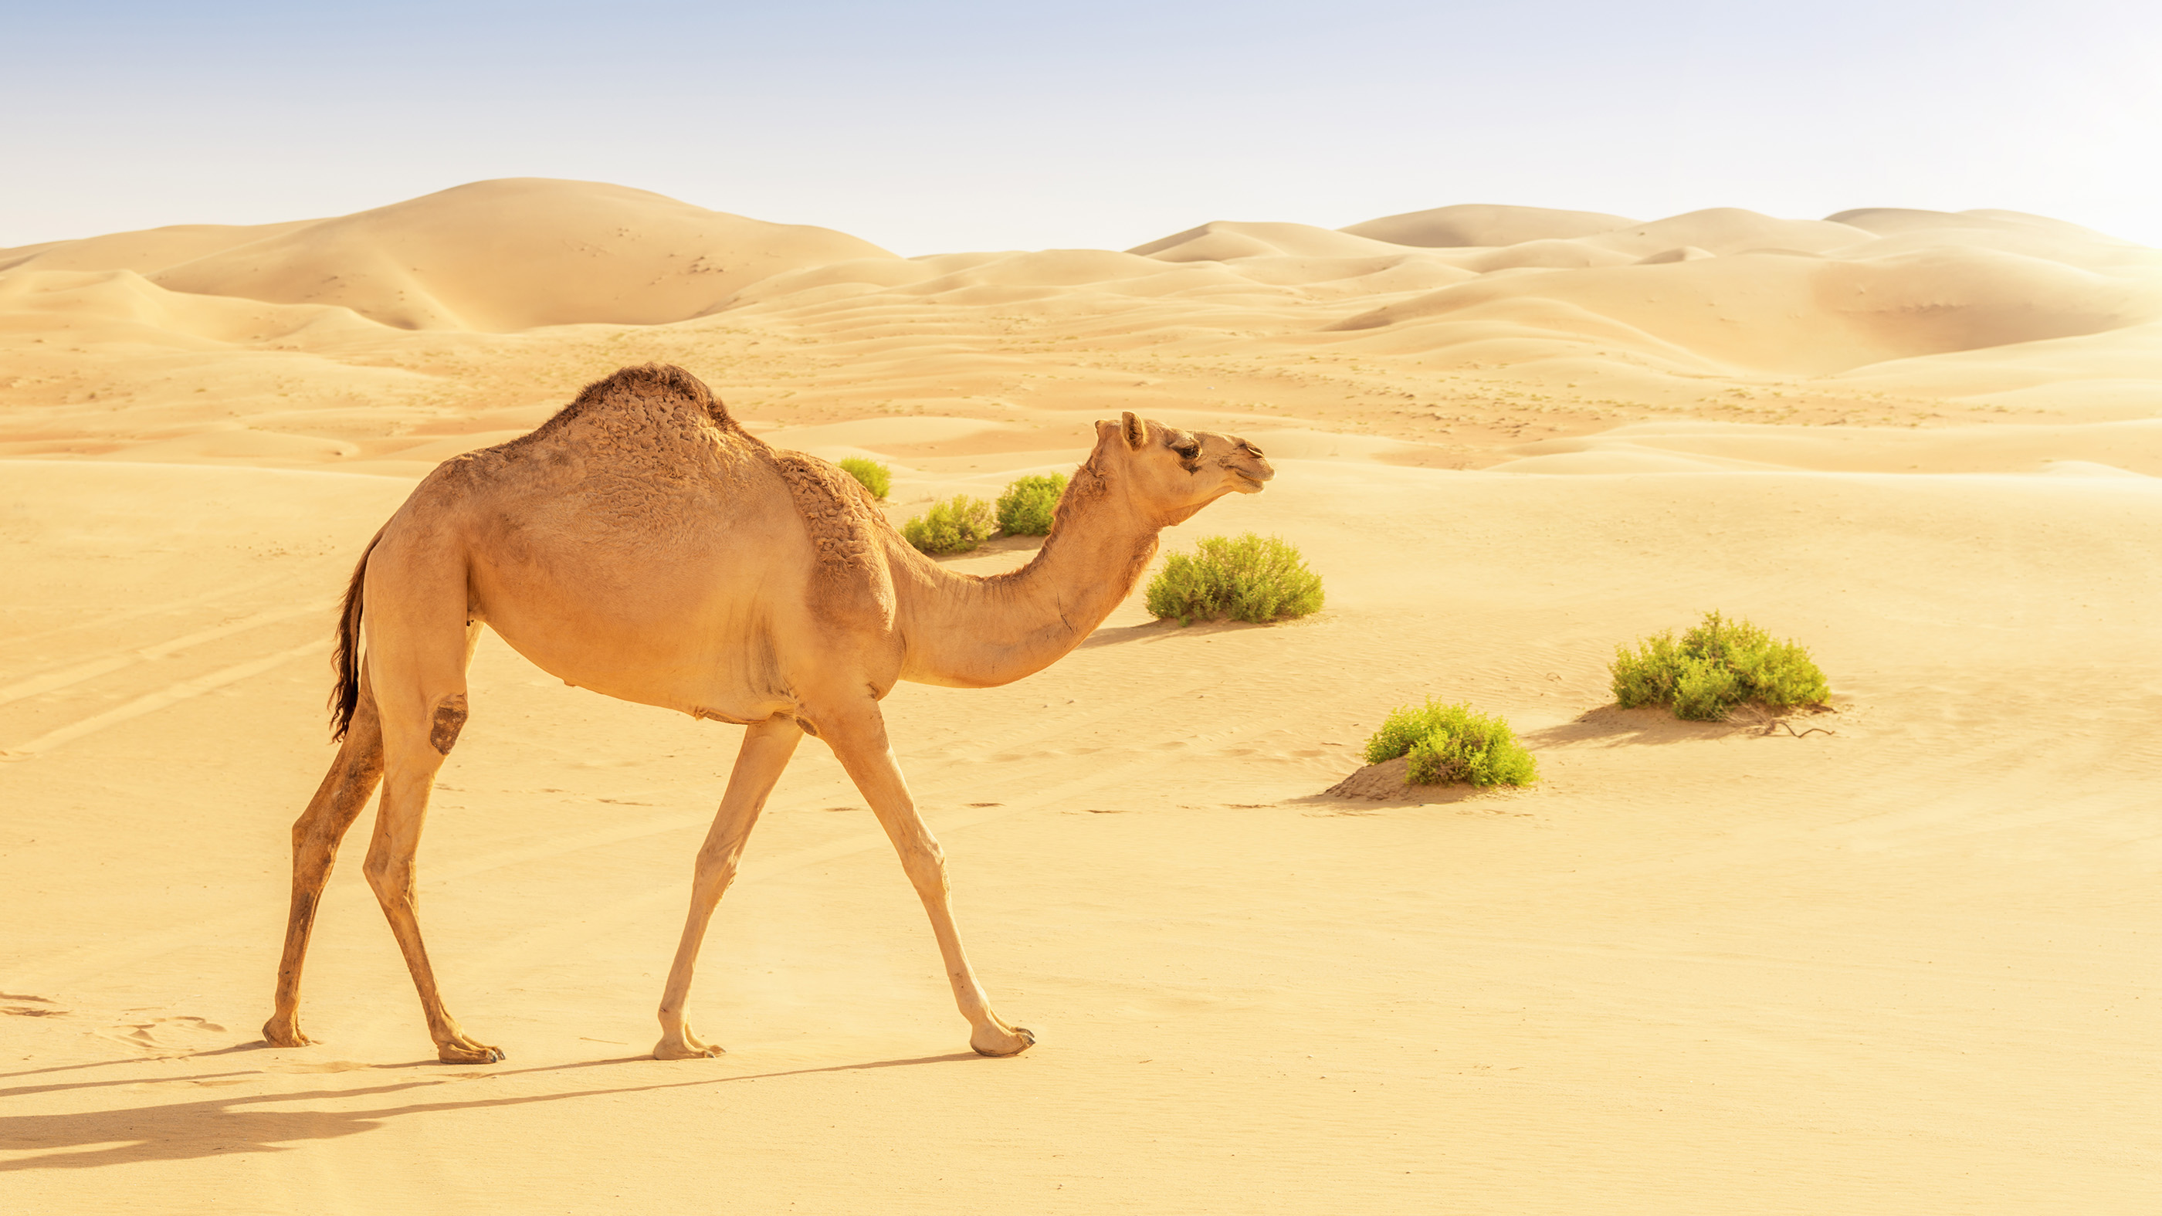
Introduction to Camels
- Camels are large mammals known for their distinctive humps and adaptability to arid environments.
- They are often referred to as the 'ships of the desert' due to their ability to travel long distances in harsh conditions.

Slide 2
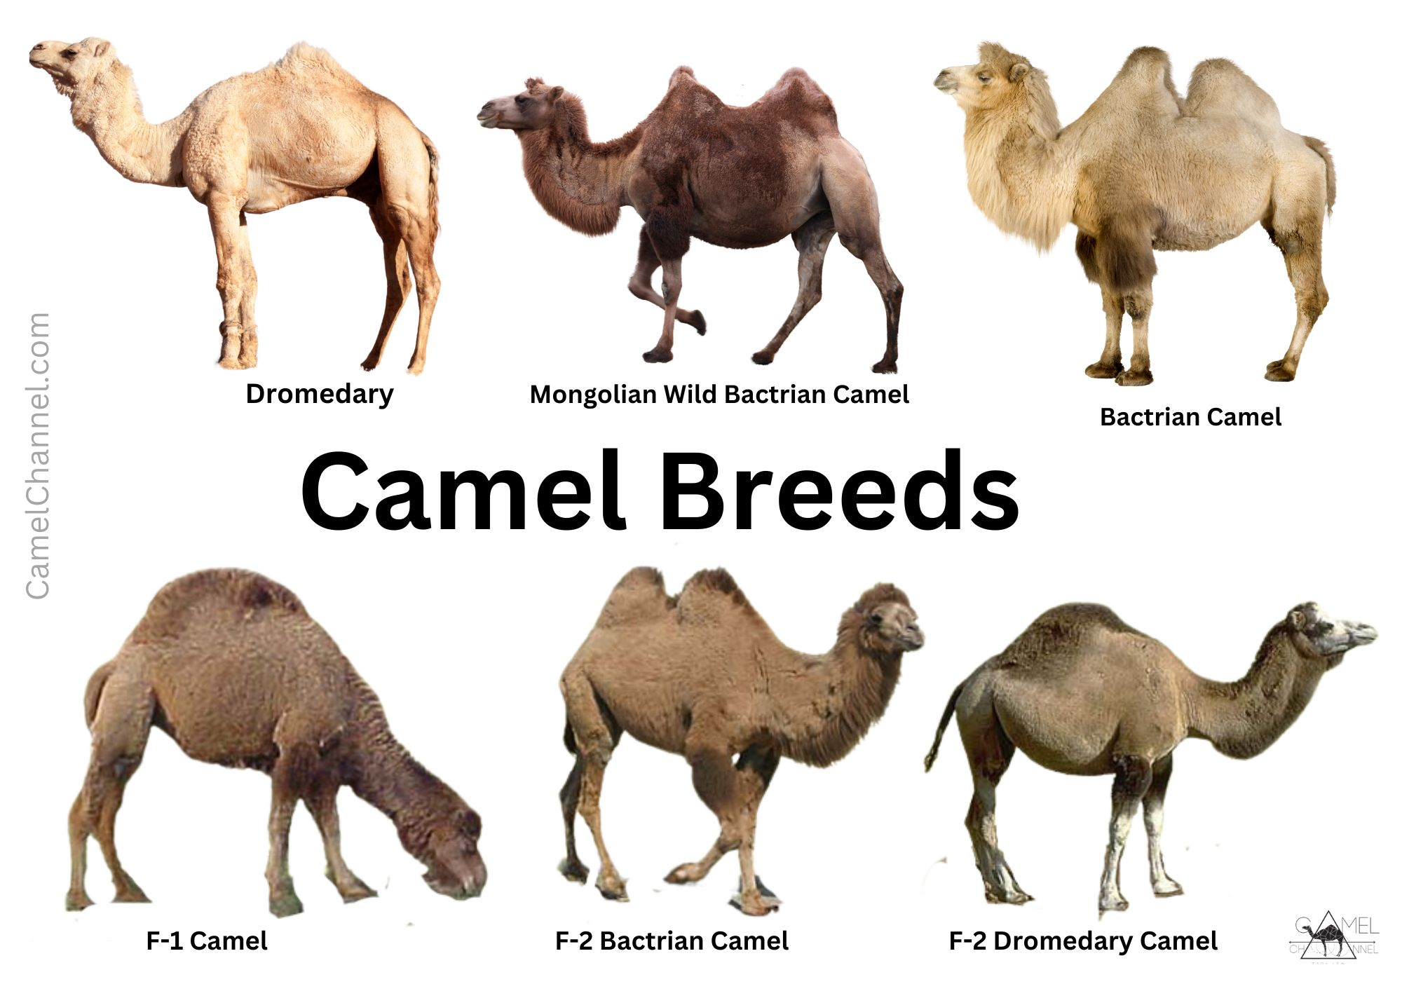
Types of Camels
- There are two main species of camels: the Dromedary, which has one hump, and the Bactrian, which has two humps.
- Dromedaries are more common and are primarily found in North Africa and the Middle East.

Slide 3

Adaptations to Desert Life
- Camels can survive without water for long periods, as they can drink up to 40 gallons in one go when needed.
- Their bodies are adapted to withstand extreme heat, with specialized nasal passages that help conserve moisture.

Slide 4
Importance to Humans
- Camels have been domesticated for thousands of years and are used for transportation, milk, and meat.
- They play a crucial role in the livelihoods of many desert communities.

Slide 5
Conservation Status
- Some camel species are facing threats due to habitat loss and climate change.
- Conservation efforts are essential to protect these unique animals and their ecosystems.

